Slide 1
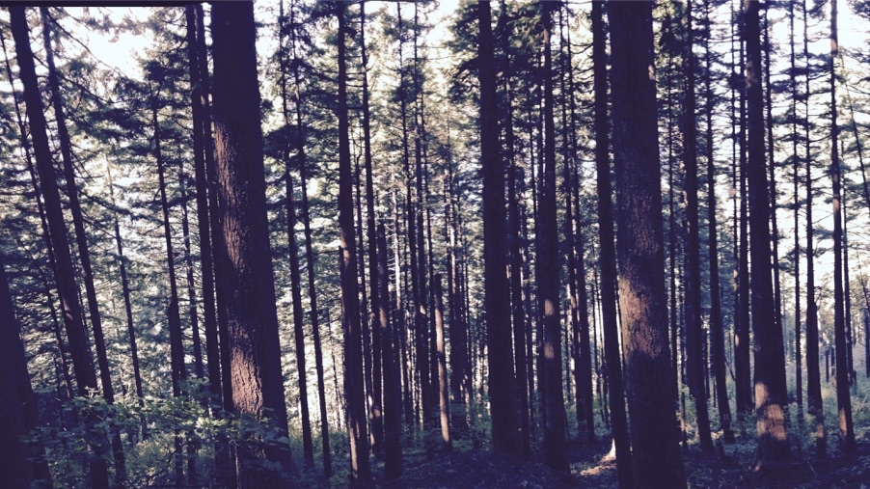
How does optimal photosynthetic acclimation affect future carbon and nutrient cycling?
Nick Smith¹, Trevor Keenan^{2,3}, Qing Zhu³, & Bill Riley³
¹Texas Tech University
²University of California Berkeley
³Lawrence Berkeley National Laboratory

Slide 2
Photosynthesis connects carbon and nutrient cycles
nick.smith@ttu.edu; @nick_greg_smith
Walker et al. (2020)

Slide 3
Photosynthesis connects carbon and nutrient cycles
nick.smith@ttu.edu; @nick_greg_smith
Walker et al. (2020)

Slide 4
A typical LSM photosynthesis scheme
nick.smith@ttu.edu; @nick_greg_smith
Climate
Soil N
Leaf N
Photosynthesis

Slide 5
nick.smith@ttu.edu; @nick_greg_smith
Kattge et al. (2009)

Slide 6
Nutrients thus provide constraints on future productivity
nick.smith@ttu.edu; @nick_greg_smith
“No limitation” simulation
“Nutrient limitation” simulations
Weider et al. (2015)

Slide 7
Some evidence suggests this is partly determined by photosynthesis
nick.smith@ttu.edu; @nick_greg_smith
mean: -15%
Smith and Keenan (2020)

Slide 8
There is another explanation for this effect: photosynthetic optimality
nick.smith@ttu.edu; @nick_greg_smith
(P > 0.05)
Smith and Keenan (2020)

Slide 9
Biochemistry optimization: Coordination hypothesis
nick.smith@ttu.edu; @nick_greg_smith
Optimal setup = equal limitation by all factors

Slide 10
Optimally: electron transport-limited (A_{j}) = Rubisco-limited (A_{c})
nick.smith@ttu.edu; @nick_greg_smith
A_{j} = A_{c}
A_{j} = f{light, T, CO₂}
A_{c} = f{V_{cmax}, T, CO₂}
Smith et al. (2019)

Slide 11
nick.smith@ttu.edu; @nick_greg_smith
V_{cmax} = f {light, T, CO₂}
Smith et al. (2019)

Slide 12
A typical LSM photosynthesis scheme
nick.smith@ttu.edu; @nick_greg_smith
Climate
Soil N
Leaf N
Photosynthesis

Slide 13
Least cost optimality model
nick.smith@ttu.edu; @nick_greg_smith
Climate
Leaf N
Photosynthesis

Slide 14
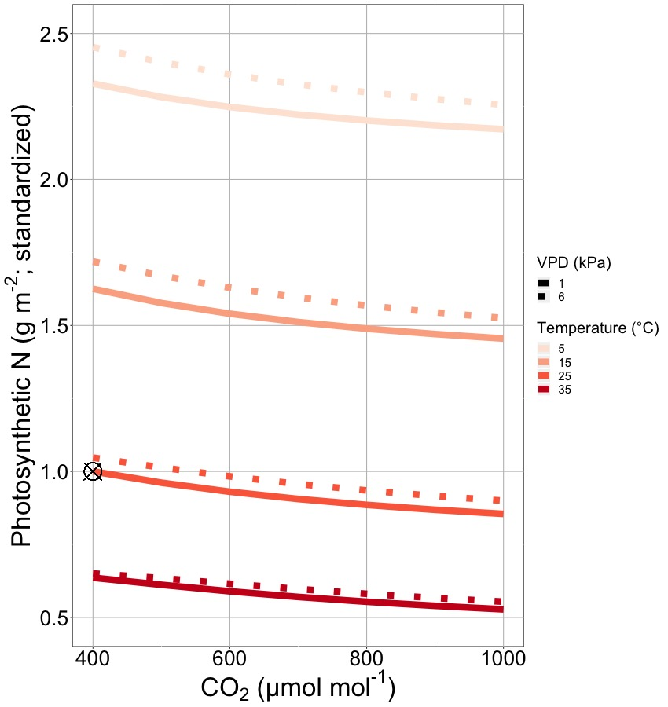
Optimality suggests that leaf nitrogen will decrease with warming and elevated CO₂
nick.smith@ttu.edu; @nick_greg_smith
Smith and Keenan (2020)

Slide 15

Let’s run a model out into the future!
nick.smith@ttu.edu; @nick_greg_smith
Qing Zhu (LBNL)

Slide 16
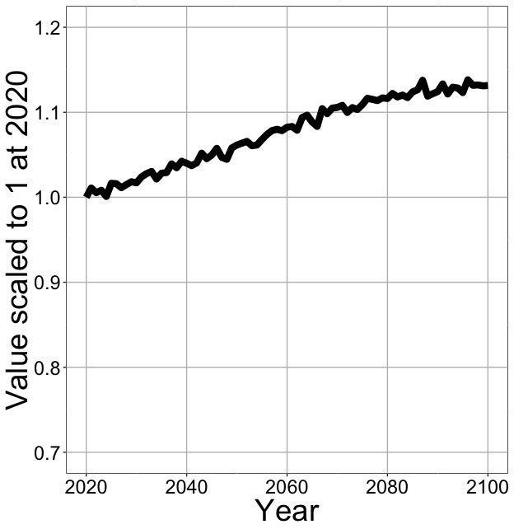
Photosynthesis increases in future
nick.smith@ttu.edu; @nick_greg_smith
Net Photosynthesis
Smith et al. (in prep)

Slide 17
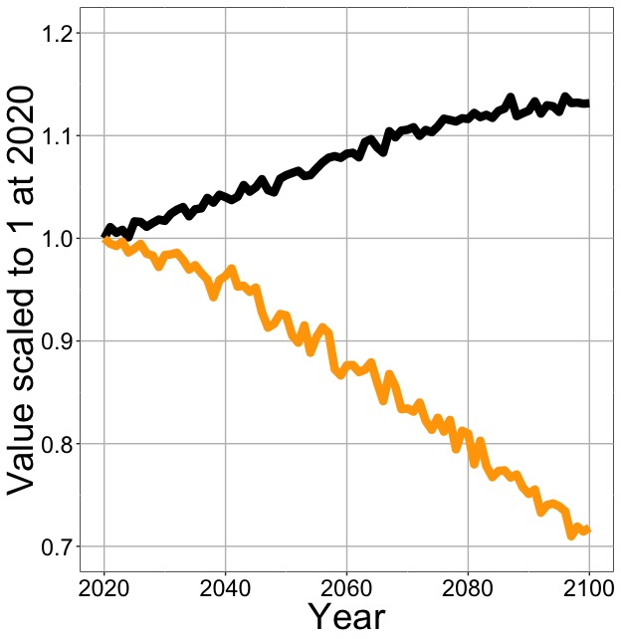
Photosynthesis increases in future (at lower nutrient use)
nick.smith@ttu.edu; @nick_greg_smith
Net Photosynthesis
Leaf Nitrogen
Smith et al. (in prep)

Slide 18
Photosynthesis increases in future (at lower nutrient use)
nick.smith@ttu.edu; @nick_greg_smith
Net Photosynthesis
Base ELM shows <5% change in leaf N
Leaf Nitrogen
Smith et al. (in prep)

